Slide 1
AI-Based Phishing Detection
Muhammad Chaudry
Joshua Webber
Yaseen Allan
Sufyan Imran

Slide 2
The Problem
Modern anti-phishing techniques/tools prove themselves to be lackluster.
Rule-based filters often miss sophisticated variants.
High false positive rates are produced.
Lacks explanations as to why something is flagged.
A user becomes more vulnerable without education.
Consistent need to update manually-added rule/condition sets.
There is an apparent need to solve the inefficiency and inaccuracy of current systems.

Slide 3
System Architecture
1. Incoming Email
2. Feature Extraction (headers, links, body text, etc.)
3. AI Classification Model (phishing/legitimate)
4. Explainability Module
5. User / Analyst Alert
The provided pipeline describes the chronological order our model goes through.
Provides:
Quality phishing verdicts.
Human-readable explanation.
Benefits:
Builds trust.
Visibility into decision making.

Slide 4
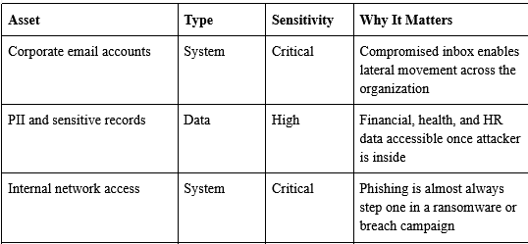
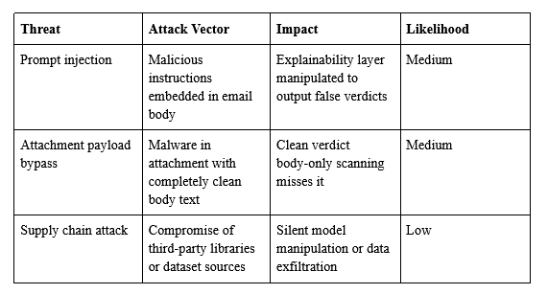
Critical Assets + Risks
Assets
Risks
User Credentials
Corporate Emails
AI Modelling
Training Datasets
Internal Network
Credential Harvesting
Lateral Movement
Silent Manipulation
Data Poisoning
Breach/Ransomware

Slide 5
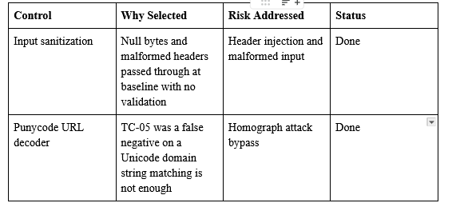
Defensive Controls
Control
Purpose
CN-1. Input Sanitization
CN-2. Punycode decoder
CN-3. Rate Limiting
CN-4. Audit Logging
CN-5. Threshold Calibration
CN.1 -> Prevents malformed input.
CN.2 -> Detects homograph domains.
CN.3 -> Mitigates threshold probing.
CN.4 -> Detects insider abuse
CN.5 -> Reduces false positive rates

Slide 6

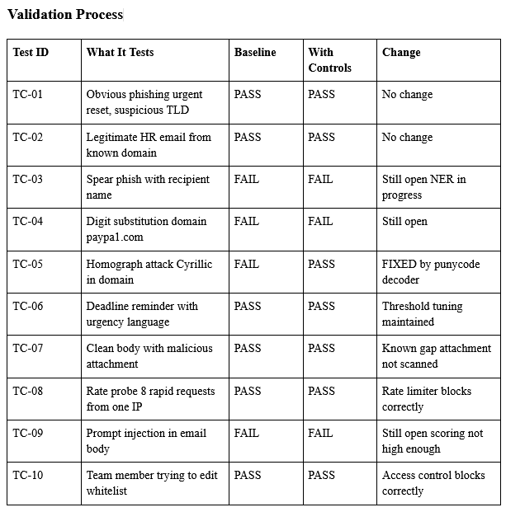
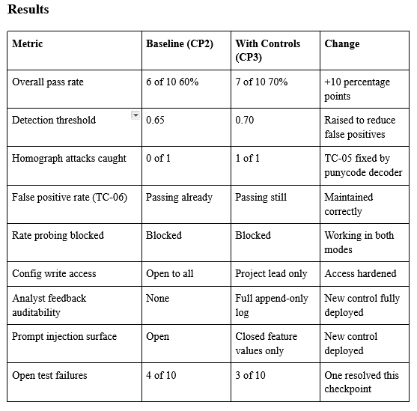
Validation Results
(LEFT) A list of different test cases applied to the AI model, involving different variations (obvious, not so obvious, legit, etc.)
(RIGHT) The results of implementing our defensive controls between Checkpoints 2 and 3.

Slide 7
Final Recommendations
Rec. 1: Schedule Monthly Revalidations
Datasets used for testing are significantly outdated. Further use of the model will require more recent data.
Rec. 2: Expand test casing
10 cases were enough for basic control validation; however, further testing is needed to produce accurate metrics.
Rec. 3: Implement Named-Entity Recognition
There is currently no system in place to capture external senders referencing internal context, such as a name and a role. This should be incorporated for further model accuracy improvements.

